Slide 1
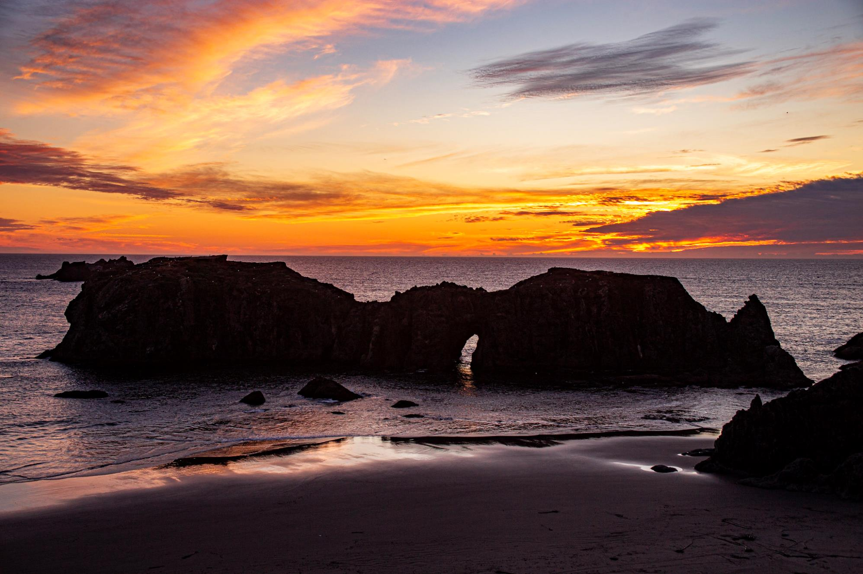

Oregon
Ocean Policy Advisory Council Meeting
May 7, 2025

Slide 2



Welcome and Zoom Meeting Guidelines
Zoom Participant Meeting Expectations and Procedures
Muting : OPAC Members - Please keep muted
unless speaking.
OPAC Members: Please use chat and/or raise your hand to indicate you would like to speak
Public Comment: Attendees - please indicate through chat that you’d like to provide public testimony
For technical support, contact at: Amanda Macnab @ Amanda.L.MACNAB@dlcd.oregon.gov or 971-720-0365
Eva Krukowski@ eva.krukowski@dlcd.oregon.gov or (971) 446-1529

Slide 3

OPAC May 7, 2025 Meeting Agenda
9:00 am Welcome and Member Introductions
9:15 am Review and Approval of the Draft Meeting Summary
9:30 am Oregon Offshore Wind Energy Roadmap Update and Discussion
10:15 am OPAC Offshore Wind Energy Working Group Update.
10:30 am OPAC Scientific and Technical Advisory Committee Actions
Action Item: Approval of nominated STAC members
10:45 am Break (15 minutes)
11:00 am PacWave Project Update
11:30 am Oregon Ocean Science Trust Update
12:00 pm Break (30 min)
12:30 pm Lunch Presentation - The Oregon Kelp Alliance Project
1:00 pm Public Comment
1:30 pm OAH Council Action Plan Process Update
1:45 pm TSP Part Three Rocky Habitat Management Strategy Update
2:30 pm Break (15 min)
2:45 pm Existing Federally Funded Ocean Research & Management Panel
3:30 pm Ocean Related Federal Executive Orders or Actions
3:45 pm OPAC Officer Elections
4:15 pm Recap, Meeting Scheduling, and Wrap-Up
4:30 pm Adjourn

Slide 4
Member Introductions
Voting Council Members
Member Name | Seat
Susan Chambers - Chair | Commercial Ocean, - South Coast, Brookings
Tara Brock – Vice-Chair | Coastal Conservation or Environmental Organization
Jamie Fereday | Coastal; Public At Large
Nick Edwards | Ports, Marine Transportation or Navigation
Margaret Corvi | Confederated Tribes of Coos, Lower Umpqua, and Siuslaw Indians
Richard Heap | Charter, Sport Fishing, Recreation ocean - S. Coast, Brookings
Vacant | Charter, Sport Fishing, Recreation ocean, N. Coast
Vacant | Statewide Coastal; Public At Large
Joe Liebezeit | Statewide Conservation/Environmental Organization
Vacant | Coos, Curry, Douglas & Lane Counties Representative
Amelia O’Connor | Non-consumpitve Recreation
Mark Kujala | Tillamook, Lincoln & Clatsop Counties Representative
Fran Recht | Elected City Official
Vacant | Commercial Ocean - North Coast, Astoria

Slide 5
Member Introductions
Ex Officio Council Members
Member Name | Seat
Ray Monroe | Coastwide Organization representing small ports and local governments
Lisa Sumption (Laurel Hillmann) | Oregon Parks and Recreation Department
Scott Groth | Oregon Department of Fish and Wildlife
Karina Nielsen | Oregon State University Sea Grant Director
Rian Vanden Hooff | Department of Environmental Quality
Nataliya Stranadko | Department of State Lands
Karin Power/Chandra Ferrari | Gov’s Office Advisor
Jon Allan | Department of Geology and Mineral Industries
Alexis Taylor | Department of Agriculture.
Lisa Phipps | Department of Land Conservation and Development
Steve Shipsey | Department of Justice
Kris Wall | National Oceanic and Atmospheric Administration

Slide 6
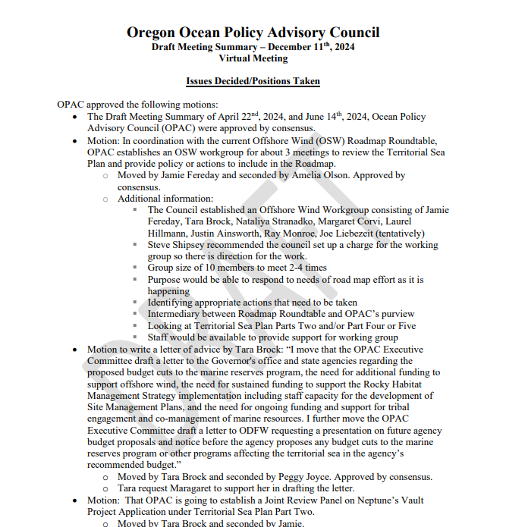
Approval of the
December 11, 2024
Draft Meeting Summary
Any revisions?

Slide 7
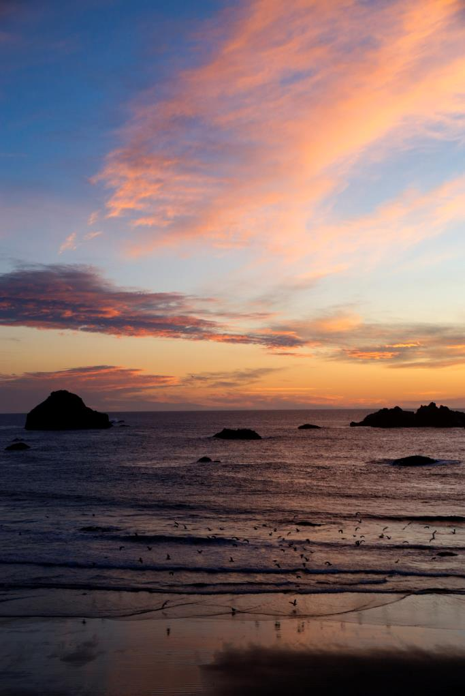
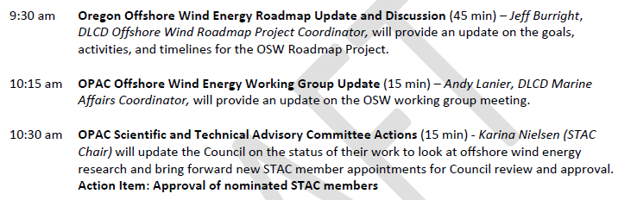
OPAC May 7, 2025
Offshore Wind Agenda Items

Slide 8
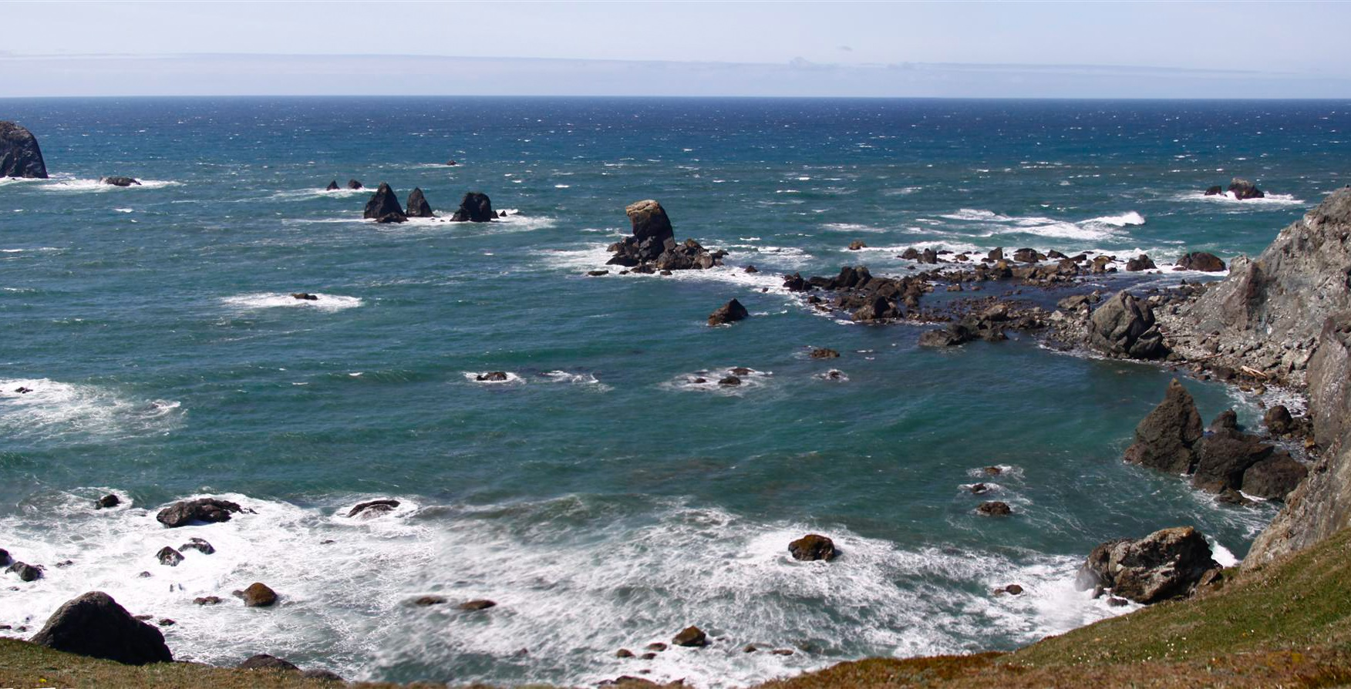

Offshore Wind Energy Roadmap Status Update
Jeff Burright, Offshore Wind Roadmap Coordinator
May 7, 2025

Slide 9
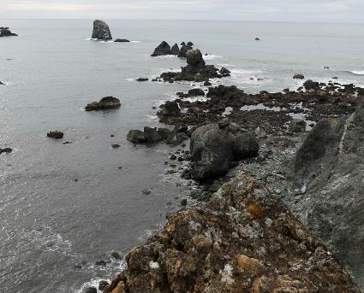
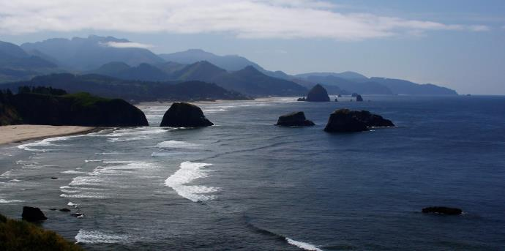
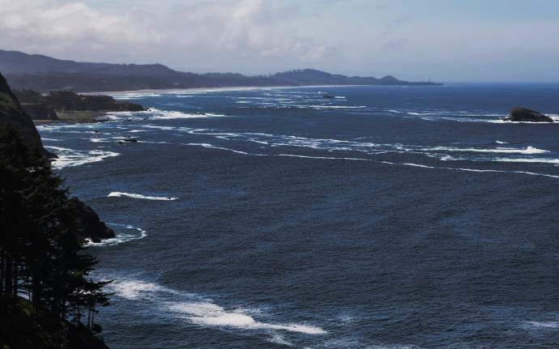
OPAC
Territorial Sea Plan
Offshore Wind Work Group
Meeting #1 Summary
May 7, 2025
Andy Lanier
Andy.Lanier@dlcd.Oregon.gov
Marine Affairs Coordinator
Oregon Coastal Management Program

Slide 10
OPAC STAC Placeholder

Slide 11
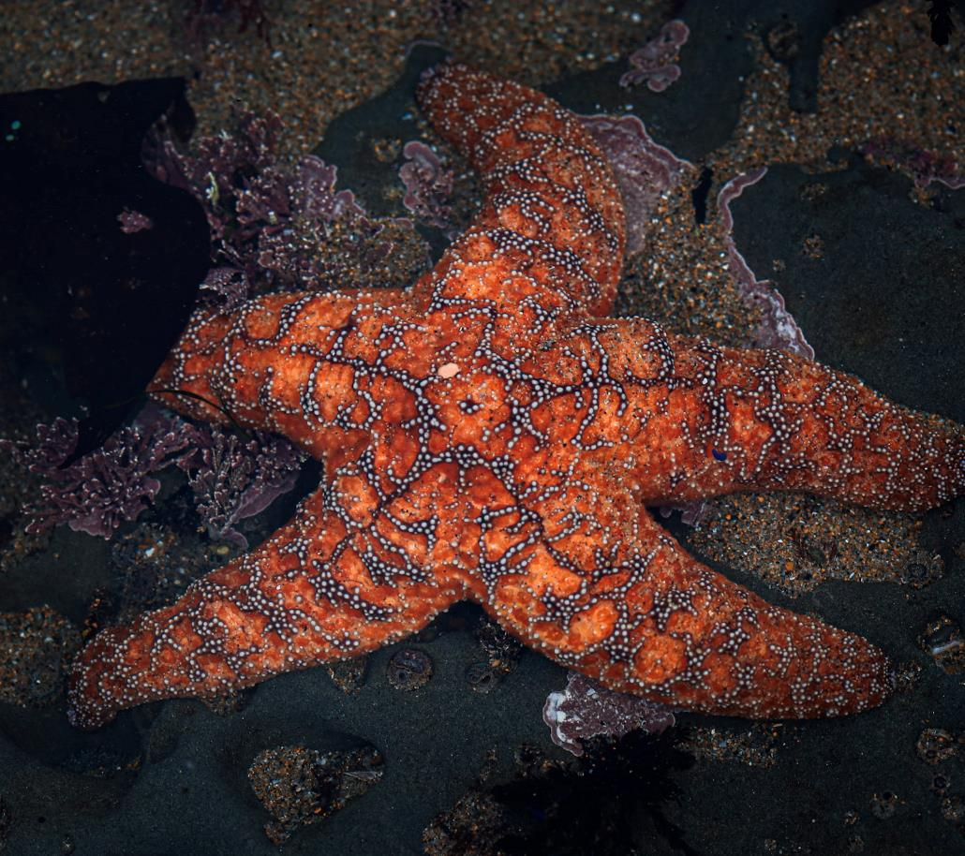
Break
Reconvene at 11:00 AM

Slide 12
OPAC May 7, 2025 Meeting Agenda - AM
9:00 am Welcome and Member Introductions
9:15 Review and Approval of the Draft Meeting Summary
9:30 Oregon Offshore Wind Energy Roadmap Update
10:15 OPAC Offshore Wind Energy Working Group Update.
10:30 OPAC Scientific and Technical Advisory Committee Actions
Action Item: Approval of nominated STAC members
10:45 Break (15 minutes)
11:00 PacWave Project Update
11:30 Oregon Ocean Science Trust Update
12:00 Break (30 min)
12:30 pm Lunch Presentation - The Oregon Kelp Alliance Project

Slide 13
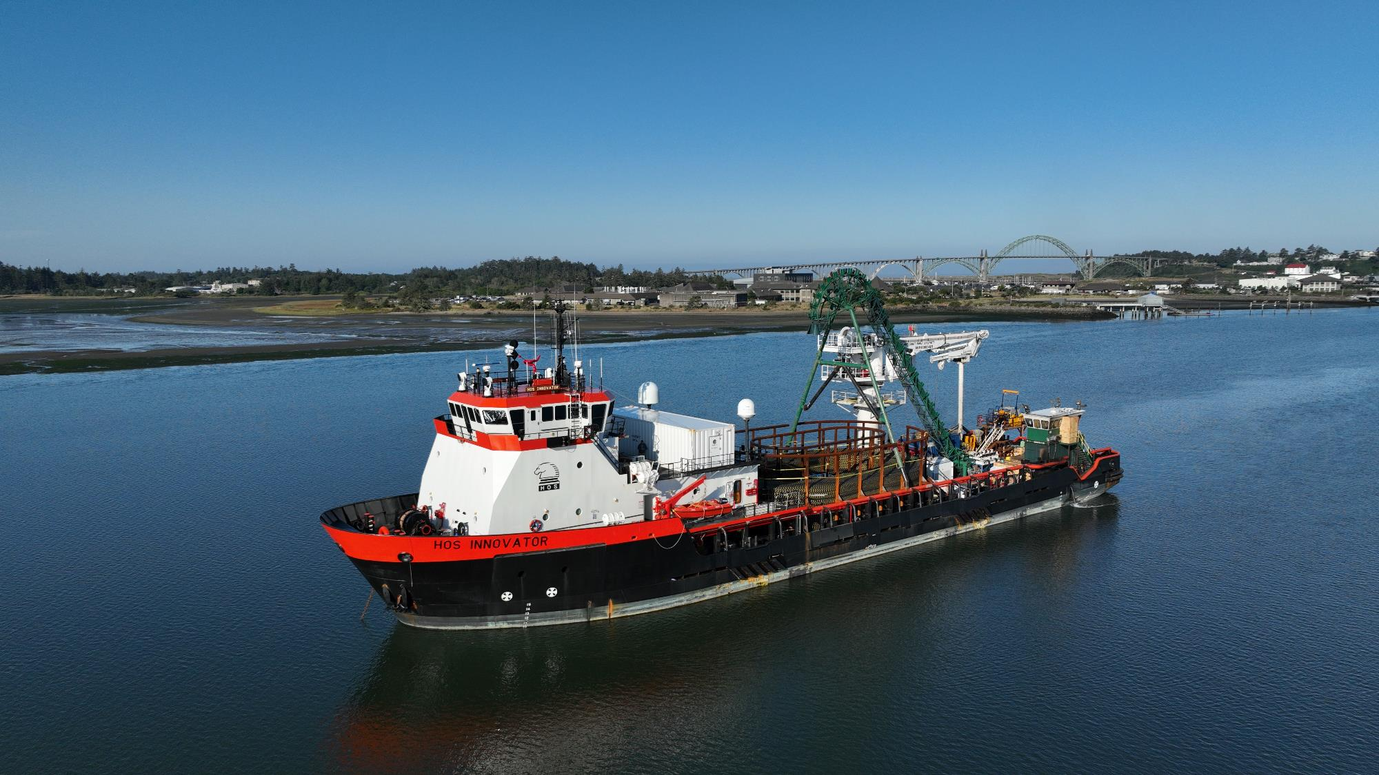


PacWave Update
Ocean Policy Advisory Council
May 7, 2025
Dan Hellin
Director, PacWave

Slide 14
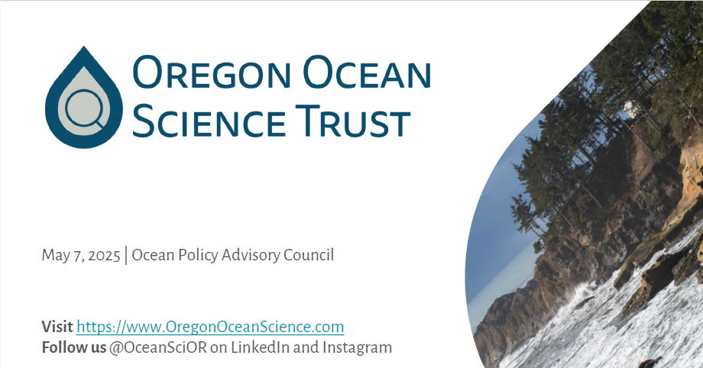
Oregon Ocean Science Trust Update
Laura Anderson, OOST Chair

Slide 15
Break
Reconvene at 12:30 pm

Slide 16
OPAC May 7, 2025 Meeting Agenda - PM
1:00 Public Comment
1:30 OAH Council Action Plan Process Update
1:45 TSP Part Three Rocky Habitat Management Strategy Update
2:30 Break (15 min)
2:45 Existing Federally Funded Ocean Research &
Management Panel
3:30 Ocean Related Federal Executive Orders or Actions
3:45 OPAC Officer Elections
4:15 Recap, Meeting Scheduling, and Wrap-Up
4:30 pm Adjourn

Slide 17


Slide 18
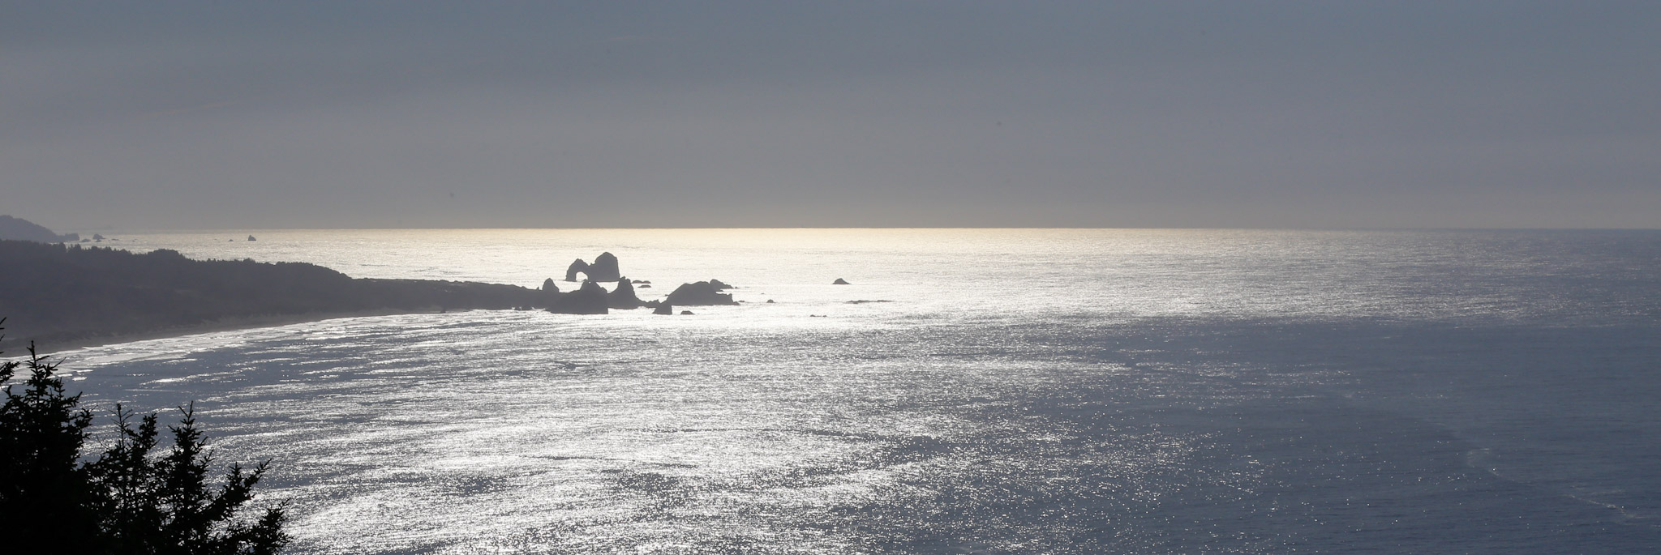
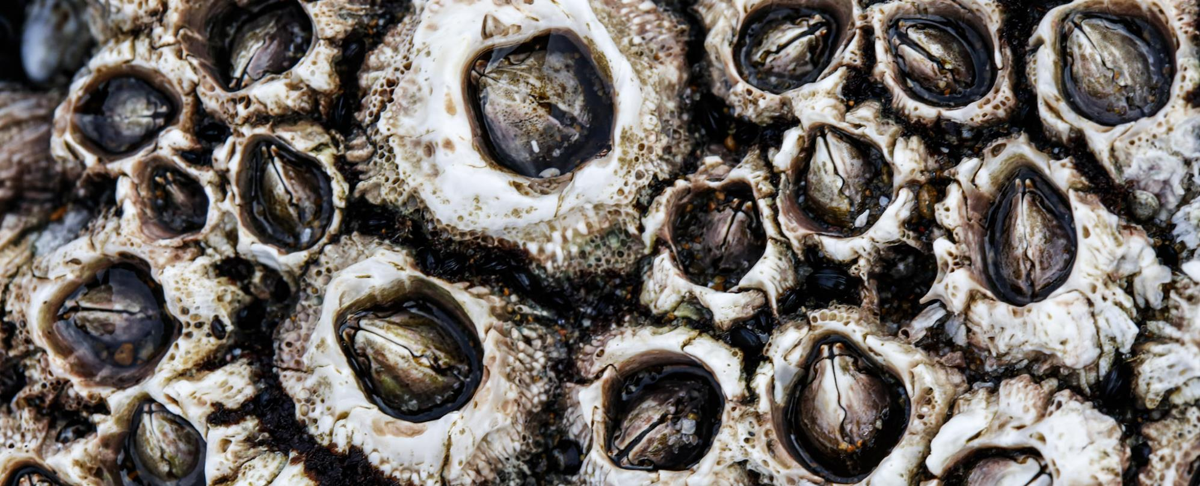
Public Comment
Please indicate in the chat if you’d like to provide public testimony
Please limit testimony to 3 minutes.

Slide 19
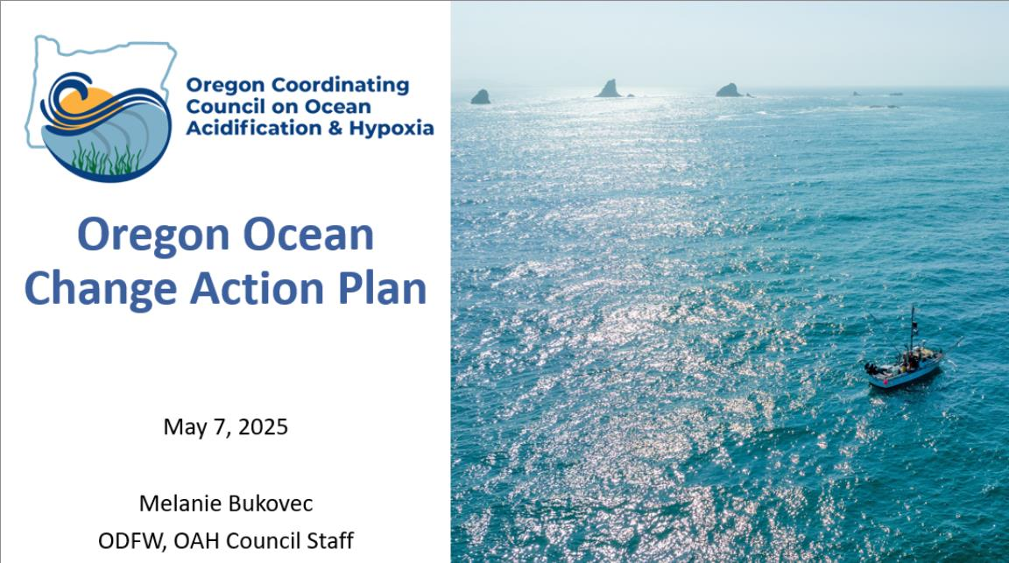
Public Comment

Slide 20
Existing Federally Funded
Ocean Research & Management Panel
The OPAC presents a panel of speakers to highlight federally funded research or management program efforts for Oregon’s ocean. Speakers will include, at a minimum:
Justin Ainsworth, Oregon Department of Fish and Wildlife
Bob Cowen, Hatfield Marine Science Center
Patricia Fox, Director of the South Slough National Estuarine Research Reserve
Jan Newton, Director of Northwest Association of Networked Ocean Observatory Systems
Lisa Phipps, Oregon Coastal Management Program

Slide 21
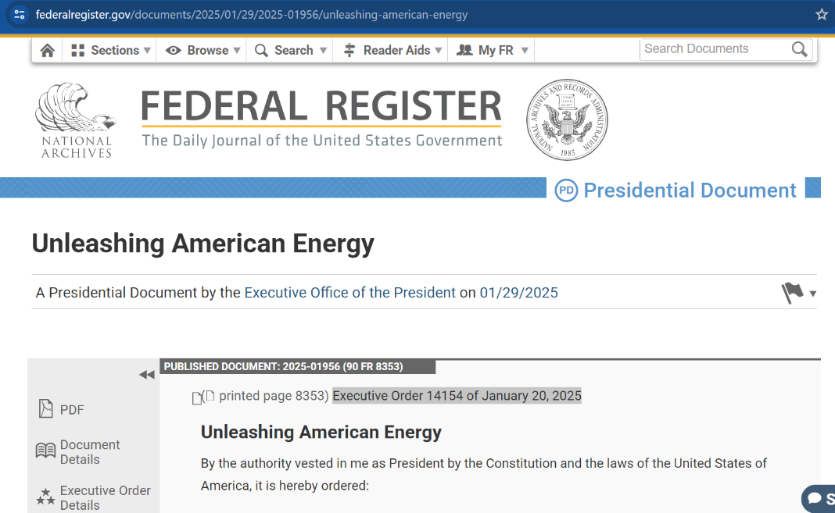
Ocean Policy Related Federal Actions
Unleashing American Energy Executive Order 14154
Sec. 2 . Policy. It is the policy of the United States:
to encourage energy exploration and production on Federal lands and waters, including on the Outer Continental Shelf, in order to meet the needs of our citizens and solidify the United States as a global energy leader long into the future;
(b) to establish our position as the leading producer and processor of non-fuel minerals, including rare earth minerals, which will create jobs and prosperity at home, strengthen supply chains for the United States and its allies, and reduce the global influence of malign and adversarial states;

Slide 22
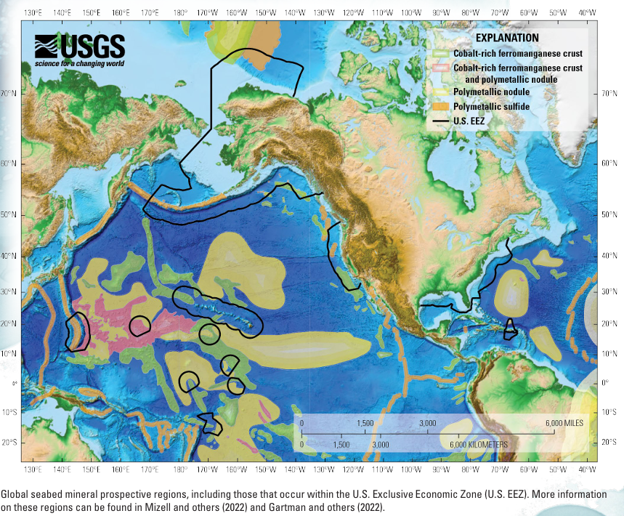
Ocean Policy Related Federal Actions
Unleashing American Energy Executive Order 14154
Sec. 2 . Policy. It is the policy of the United States:
to encourage energy exploration and production on Federal lands and waters, including on the Outer Continental Shelf, in order to meet the needs of our citizens and solidify the United States as a global energy leader long into the future;
(b) to establish our position as the leading producer and processor of non-fuel minerals, including rare earth minerals, which will create jobs and prosperity at home, strengthen supply chains for the United States and its allies, and reduce the global influence of malign and adversarial states;

Slide 23
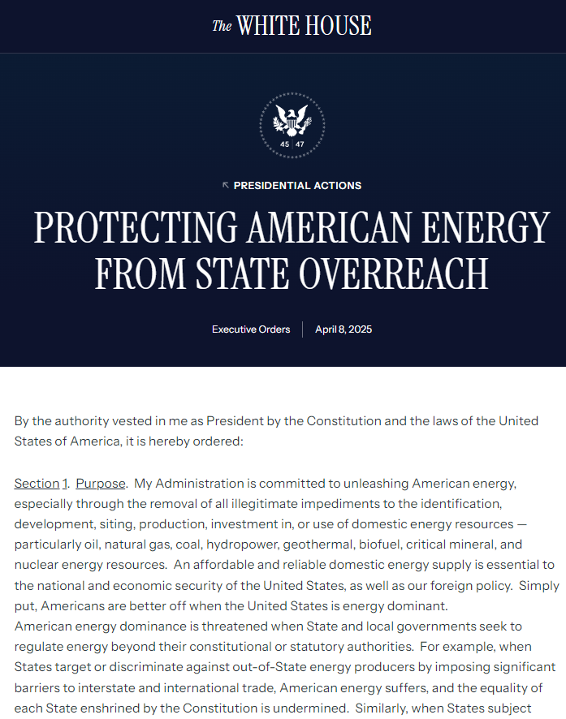
Ocean Policy Related Federal Actions
Protecting American Energy From State Overreach Executive Order
Executive Order: Protecting American Energy from State Overreach, April 8, 2025 (relating to oil and gas, coal, etc.)
This EO seeks to stop enforcement of state or local laws that aims to counteract state and local regulations that, in the administration's view, hinder national energy production and economic growth related to oil, natural gas, coal, hydropower, geothermal, biofuel, critical mineral and nuclear energy resources.
Key Provisions of the Executive Order:
Federal Preemption of State Regulations:
Targeted State Policies:
Protection of Federal Lands: The order asserts that states should not interfere with energy development activities on federal lands, emphasizing the federal government's authority over such territories; and
This executive order is part of a broader initiative by the Trump administration to promote energy dominance by reducing regulatory barriers and reinforcing federal authority over energy policy,
The Attorney General is directed to take appropriate action to stop enforcement of state laws the AG determines to be illegal and, within 60 days [June 7], submit a report to the president about the actions taken.

Slide 24
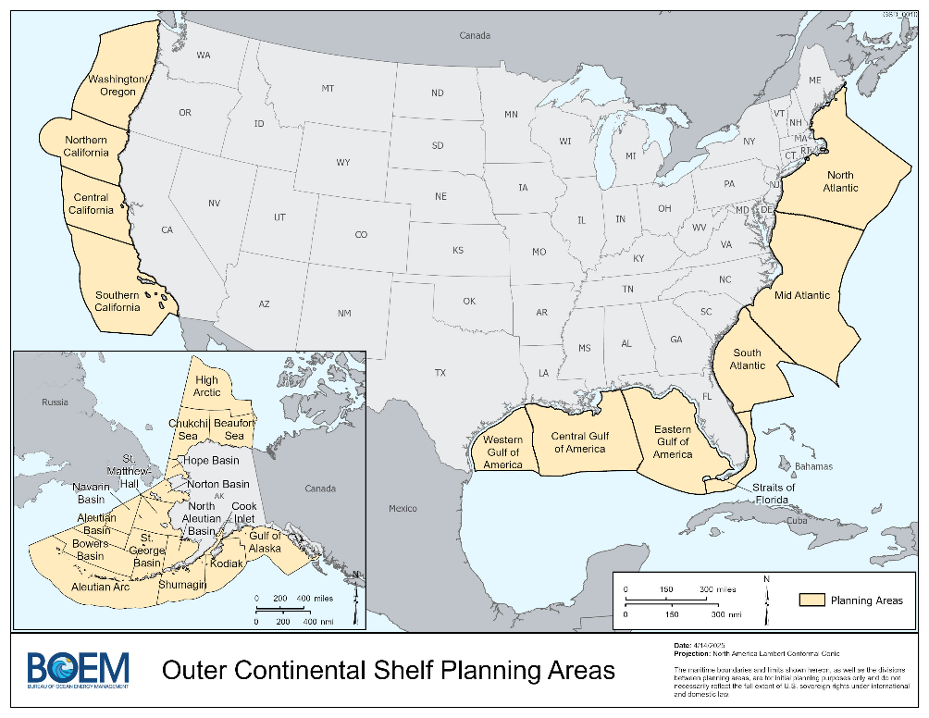
Ocean Policy Related Federal Actions
Dept of Interior Announcement: OCS Oil & Gas Leasing Program
On April 29, 2025, BOEM announced that the Request for Information (RFI) for the 11th National Oil and Gas Leasing Program would be published in the Federal Register on April 30, 2025. Publication of the RFI opened a 45-day public comment period ending on June 16, 2025. This comment period serves as the initial step in a multi-year planning process.
How to submit comments on the RFI:
Submitted through the regulations.gov web portal (preferred) at https://www.regulations.gov/document/BOEM-2025-0015-0003.

Slide 25
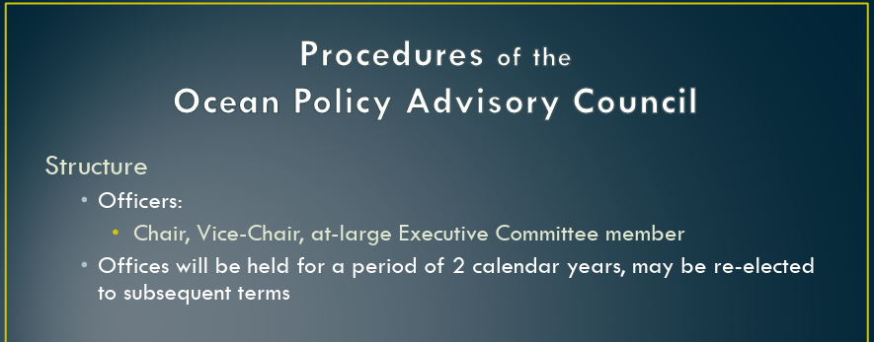
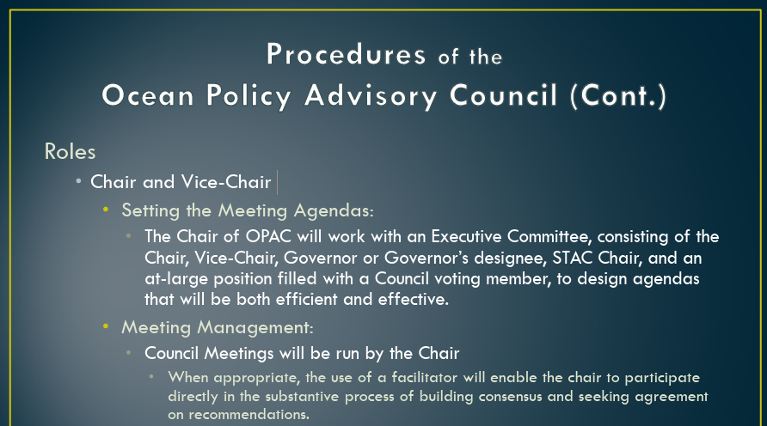
OPAC Officer Elections
2025
Current OPAC Leadership:
OPAC Chair: Susan Chambers
OPAC Vice-Chair: Tara Brock
At-Large Member: Jamie Fereday
2025-2027 Elected Leadership:
OPAC Chair:
OPAC Vice-Chair
At-Large Member

Slide 26
OPAC Motion:
May 7, 2025
ENTER MOTION LANGUAGE HERE
Results:
OPAC Motion provided by _______________: Seconded by:
Attendance Record | First Name | Last Name | Representing | Vote
Yes | Joe | Liebezeit | Statewide Conservation or Environmental Organization
Yes | Susan | Chambers | South Coast Commercial Fisheries
Yes | Nick | Edwards | Ports, Marine Transportation, Navigation
 |  |  | North Coast Commercial Fisheries
Yes | Jamie | Fereday | Public at Large - Coastal
Yes | Margaret | Corvi | Oregon Coastal Indian Tribes
Yes | Fran | Recht | Coastal City Elected Official
Yes | Richard | Heap | South Coast Charter, Sport or Recreational Fisheries
No |  |  | North Coast Charter, Sport or Recreational Fisheries.
Yes | Tara | Brock | Coastal Conservation or Environmental Organization
No |  |  | South Coastal County Commissioner
Yes | Amelia | O’Connor | Coastal Non-Fishing Recreation
Yes |  |  | Public at Large - Statewide
Yes | Mark | Kujala | North Coastal County Commissioner

Slide 27
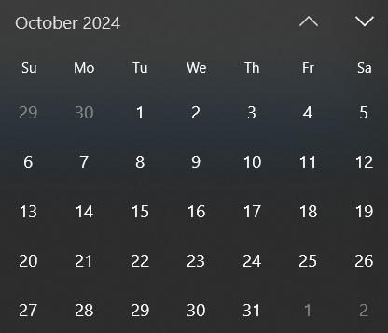
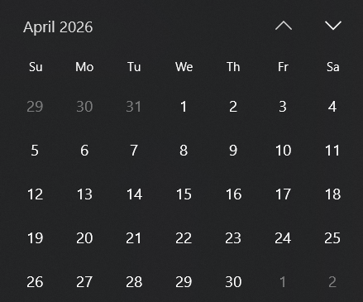
Future OPAC Meeting Planning

Slide 28
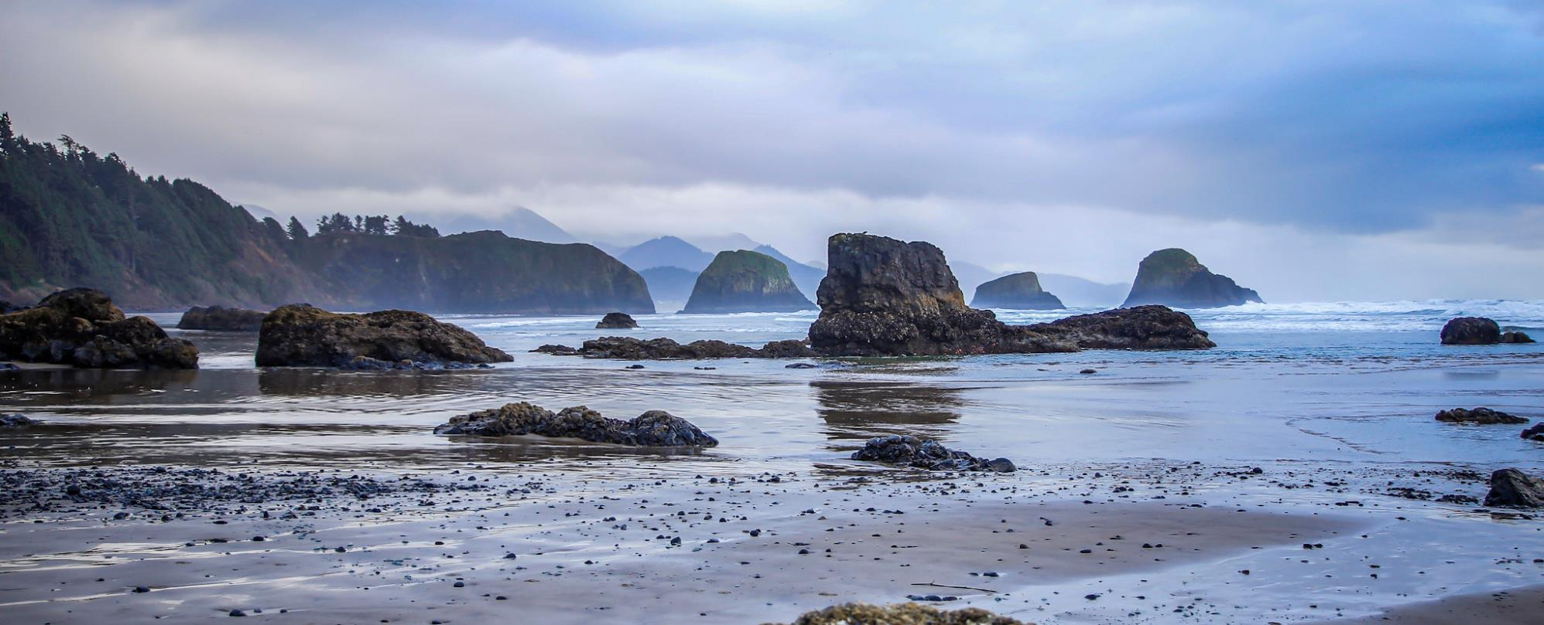
Meeting Adjourned – Thank you all!

Slide 29
OPAC Motion:
May 7, 2025
ENTER MOTION LANGUAGE HERE
Results:
OPAC Motion provided by _______________: Seconded by:
Attendance Record | First Name | Last Name | Representing | Vote
Yes | Joe | Liebezeit | Statewide Conservation or Environmental Organization
Yes | Susan | Chambers | South Coast Commercial Fisheries
Yes | Nick | Edwards | Ports, Marine Transportation, Navigation
 |  |  | North Coast Commercial Fisheries
Yes | Jamie | Fereday | Public at Large - Coastal
Yes | Margaret | Corvi | Oregon Coastal Indian Tribes
Yes | Fran | Recht | Coastal City Elected Official
Yes | Richard | Heap | South Coast Charter, Sport or Recreational Fisheries
No |  |  | North Coast Charter, Sport or Recreational Fisheries.
Yes | Tara | Brock | Coastal Conservation or Environmental Organization
No |  |  | South Coastal County Commissioner
Yes | Amelia | O’Connor | Coastal Non-Fishing Recreation
Yes |  |  | Public at Large - Statewide
Yes | Mark | Kujala | North Coastal County Commissioner

Slide 30
OPAC Motion:
May 7, 2025
ENTER MOTION LANGUAGE HERE
Results:
OPAC Motion provided by _______________: Seconded by:
Attendance Record | First Name | Last Name | Representing | Vote
Yes | Joe | Liebezeit | Statewide Conservation or Environmental Organization
Yes | Susan | Chambers | South Coast Commercial Fisheries
Yes | Nick | Edwards | Ports, Marine Transportation, Navigation
 |  |  | North Coast Commercial Fisheries
Yes | Jamie | Fereday | Public at Large - Coastal
Yes | Margaret | Corvi | Oregon Coastal Indian Tribes
Yes | Fran | Recht | Coastal City Elected Official
Yes | Richard | Heap | South Coast Charter, Sport or Recreational Fisheries
No |  |  | North Coast Charter, Sport or Recreational Fisheries.
Yes | Tara | Brock | Coastal Conservation or Environmental Organization
No |  |  | South Coastal County Commissioner
Yes | Amelia | O’Connor | Coastal Non-Fishing Recreation
Yes |  |  | Public at Large - Statewide
Yes | Mark | Kujala | North Coastal County Commissioner

Slide 31
OPAC Discussion Points Parking Lot
Add items here that OPAC wants further discussion on.
Notes.

Slide 32
Questions for OPAC Consideration:
Does OPAC agree with the idea of setting a goal for Marine Conservation Designation (as represented by either MR, MPA’s, or rocky habitat designations).
What other OPAC actions may influence capacity to initiate the next proposal process?
  Agency capacity will be limited until site management plans for the Rocky Habitat Management Areas are completed (at the earliest Spring of 2026).
  Policy amendments associated with Offshore Wind Energy
What is the OPAC guidance on initiation (start date) of the next proposal process?

